Slide 1
Group 2: Trainia
Tongwa Aka, Jonathan Schimpf, Mamadou Ndiong

Slide 2
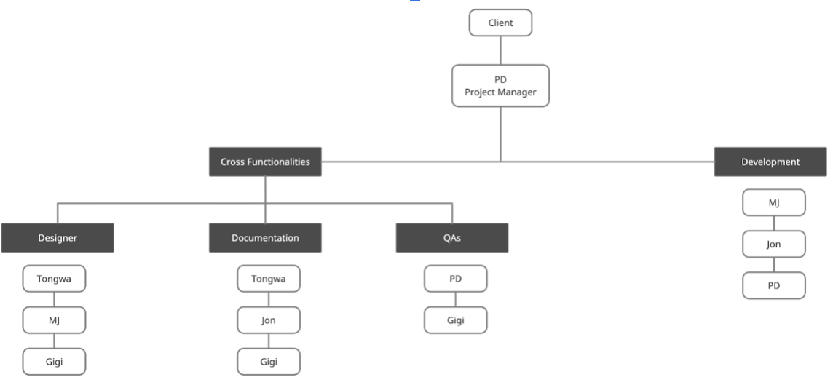
Team
Website Development:
MJ
Tongwa
Jon

Slide 3
Our Plan
Brainstorming (based on requirements):
Had to be fun
Had to be a website
Must be able to connect to social media
Teach students about healthy lifestyle and habits as well as information regarding their sport
Went between creating our website from scratch and using WordPress to help create website

Slide 4


Inspiration

Slide 5
Thus came… Trainia!
We decided on making a trivia game
Name is a pun based on “Train” and “Trivia”
Informational as students will learn healthy tips as they play the trivia game
Game will be based on a board game type system to advance through levels and raise your ranks (Competitive!)

Slide 6
Design
Meeting with Prof Broadwater:
Creating a website from scratch might not be as feasible as we thought
Maybe use WordPress for
Find other resources that could help with the website and game such as: Payment system -> PayPal

Slide 7
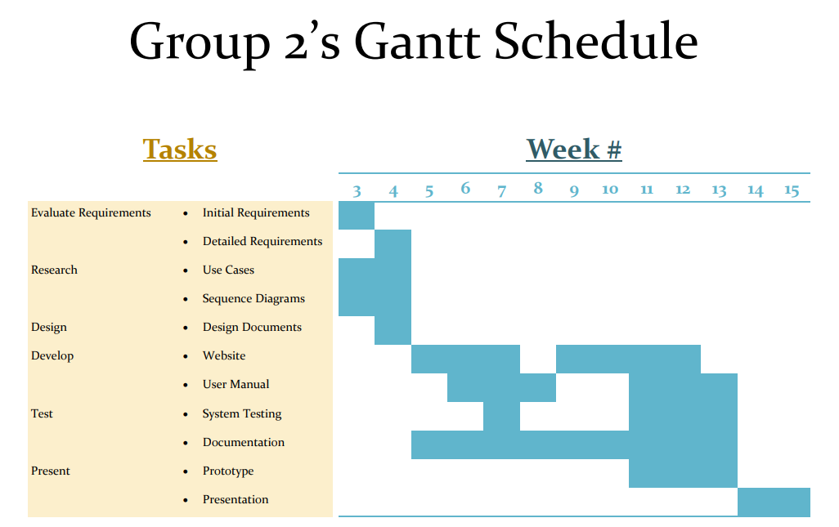

Slide 8
Where We Are Now:
Game name: Trainia
Paired programming due to unforeseen circumstances
Starting the development of Trainia’s landing page
Wordpress + plugins
Bootstrap framework and other online resources (with references/ modifications) will be used to make web based mobile friendly game

